Slide 1

A global healthcare company

Slide 2

Health challenges: what is at stake today?
Global life expectancy has doubled in average in the last century. Improvements in our living conditions through medicine and better sanitation have markedly increased life expectancy in the past decades.
Some serious diseases have been eliminated.
But, today, chronic diseases, environment and ageing-related diseases are the new struggle for our community of 7 billion people.

Slide 3
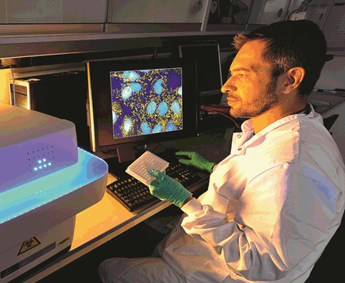
New levers are in our hands
Easier diagnosis
Better genomic understanding
Shift to prevention and better health management
Digital tools transforming health care
More proactive patients in managing their health conditions

Slide 4
Our answer: providing you a full continuum of care
Preventing diseases and reducing your health-related risks
Delivering the best healthcare solutions to handle your disease
PREVENT
TREAT
CARE CONTINUUM BY SANOFI
Supporting you to live your life
CARE

Slide 5
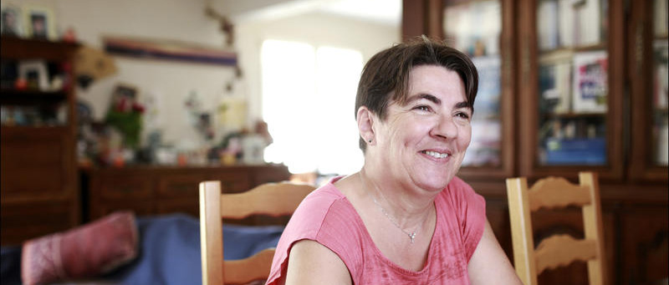
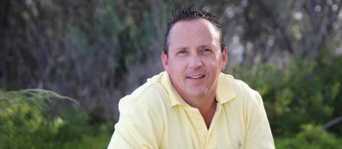

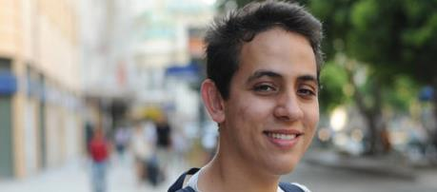
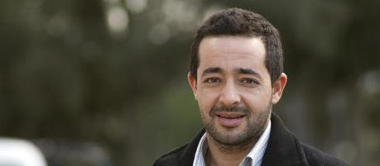
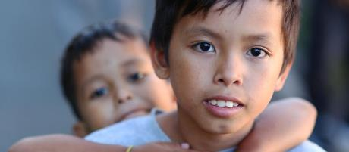
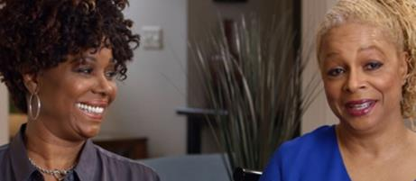
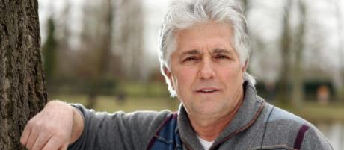
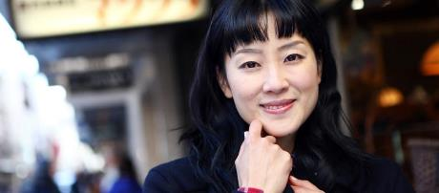
From vaccines to medicines: helping you face various health challenges
Claude, Asthma
Dean, Multiple sclerosis
Magali, Flu
Florence, Gaucher disease
Gustavo, Pompe rare disease
Abdelhadi, Diabetes
In the Philippines, Dengue immunization
Darcus and Vernee, High cholesterol
Gérard, Cancer
Mizutani, Pain

Slide 6
A commitment to your health
Sanofi, a global healthcare company, committed to preventing diseases and treating every person across the globe.
More than
100,000
employees
dedicated to making a difference on people’s daily lives.
By your side, everywhere in the world, with health solutions available in
170 countries
Our key therapeutic areas:
Diabetes
& Cardiovascular
Consumer healthcare
Specialty Care
Rare diseases
Multiple sclerosis
Oncology
Immunology
Vaccines

Slide 7






Sanofi at a glance
Based in more than
€33.821 bn
100
net sales in 2016⁽¹⁾
countries
(1) Excluding animal health activities. See the Form 20-F 2016, p.91.
Between 2015 - 2020
Dengue
With more than
Cardiovascular
100,000
6
Diabetes
major innovations⁽²⁾
Rheumatoid arthritis
employees in the world⁽¹⁾
Atopic dermatitis, Asthma
(1) Excluding animal health activities.
(2) Sanofi expects to launch 6 key products and vaccines by 2020.

Slide 8

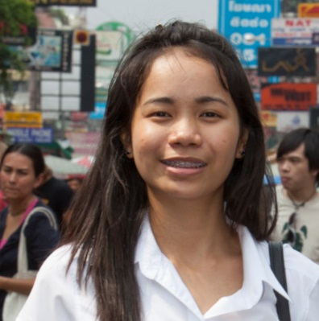
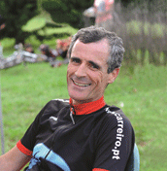
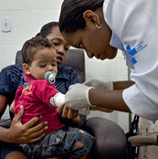

Five Global Business Units
Diabetes & Cardiovascular
General Medicines & Emerging Markets
Specialty Care
(Sanofi Genzyme)
Vaccines
(Sanofi Pasteur)
Consumer Healthcare
Rare Diseases
Multiple Sclerosis
Oncology
Immunology

Slide 9
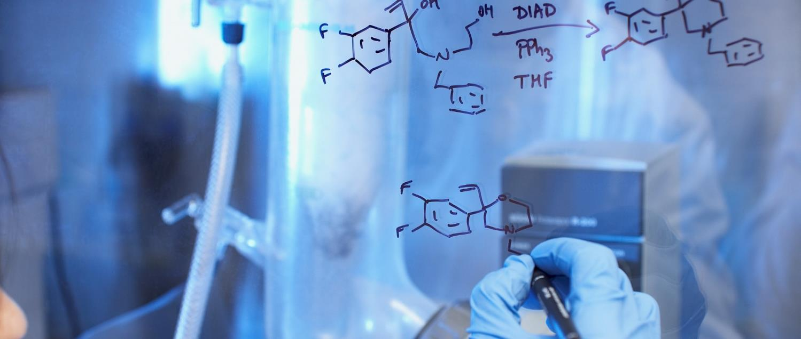
Pushing for innovation

Slide 10
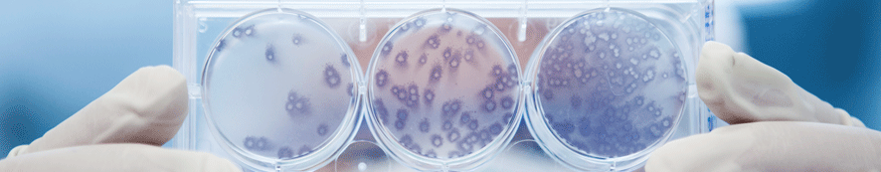
Innovating for you
Science has made enormous progress over the past 20 years.
With the unlocking of the human genome, we now understand what causes some of the most serious and chronic diseases affecting us, such as cancer, diabetes and heart diseases.
We are entering an era of personalized treatment.
Thanks to the use of very powerful technology, we are getting better at predicting how you will respond to specific treatments.
We are leveraging new biotechnologies to more effectively target disease pathways and bring break through medicines to patients faster.
At Sanofi – relying on our internal expertise and partnering with external specialists – we leverage both cutting-edge technologies and new knowledge to meet your needs as a patient.
Our goal is to contribute to healthier lives and helping you live yours to the fullest.

Slide 11



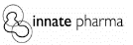
Our model of innovation
4
15.3%
R&D Hubs
across Asia, France, Germany and North America
of sales invested in R&D
Increasing annual R&D investments
from €5 to €6 bn by 2020
Diabetes⁽¹⁾
More than
16,000
Key collaborations
Genetic Diseases
employees committed to R&D
Oncology
& Immunology
(1) With Verily, ex-Google Life Sciences.

Slide 12
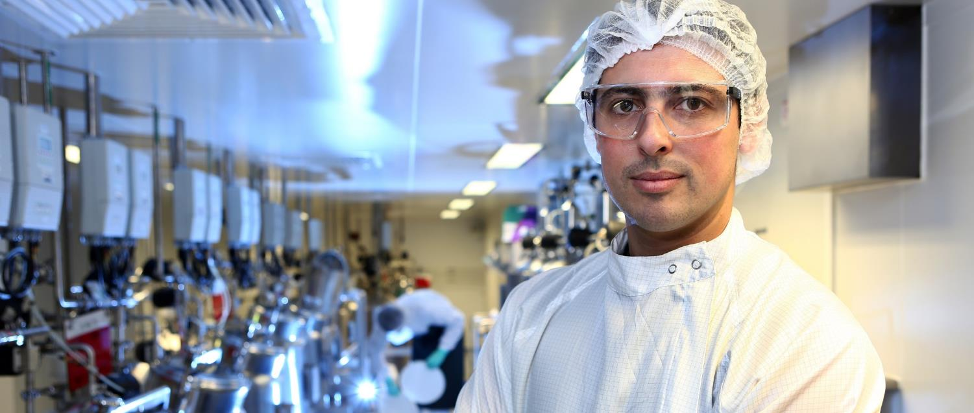
A cutting-edge manufacturing network

Slide 13

Manufacturing close to you
The Life Sciences industry is changing with the evolution of medicine and the continuous innovations offering patients new treatments.
As a result, biotechnology-produced innovations are increasingly part of our pharmaceutical production.
That’s why, at Sanofi, we have strengthened the efficiency of our industrial resources.
Regardless of where our treatments are manufactured, our industrial network provides both healthcare professionals and patients with the highest quality and maximum safety.
We are in a unique position with close to 36 sites in emerging markets, this enables us to offer adapted, region-specific characteristics.
Our industrial network is a key pillar in enabling us to deliver value to you and to the 7 billion individuals.

Slide 14

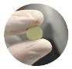
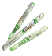
Our industrial network
Around
87
€1bn
industrial sites
invested every year
Biologics
Almost
40,000
Producing
Pills / chemistry
industrial employees
Delivery devices

Slide 15
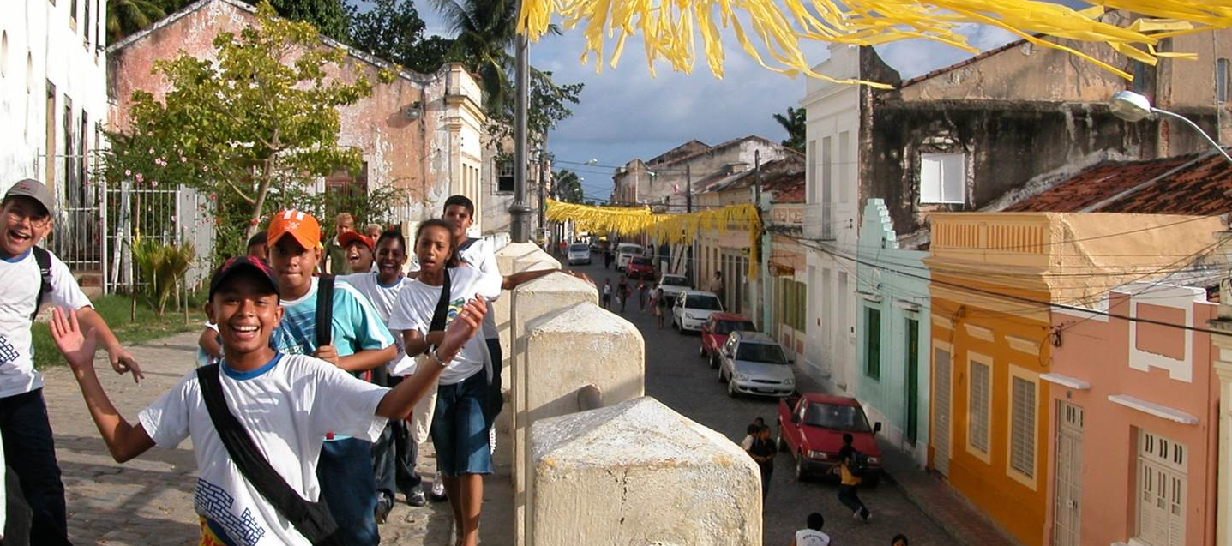
Our social responsibility

Slide 16

Promoting access to healthcare for those in need
One-third of the world’s population has no access to healthcare.
At Sanofi, we believe solutions emerge through long-lasting commitments with our partners, who work on the ground.
We fight against childhood cancer, malaria and tuberculosis, for example.
Sanofi is committed to reducing health inequalities by listening to its stakeholders and acting in a collaborative and sustainable way.
Our actions adhere to the sustainable development objectives set out by the United Nations.
We contribute to public health by improving access to treatments.
We promote the development of local communities.
And we mitigate the impact of climate change on health and limit our environmental footprint.

Slide 17






Our Corporate Responsibility
Working with partners
Recognized worldwide

Slide 18
Key figures in 2016
NET SALES BY ACTIVITES ⁽¹⁾ (in million euros)
NET SALES BY GEOGRAPHICAL AREAS ⁽¹⁾ (in million euros)
Vaccines
Other countries
13.5%
4,577
9.3%
3,158
Emerging Markets
28.4%
9,593
Europe
25.7%
8,679
Pharmaceuticals
86.5%
29,244
United States
36.6%
12,391
(1) Excluding animal health activities. See the Form 20-F 2016 p.91.

Slide 19
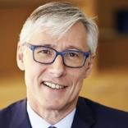
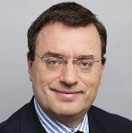
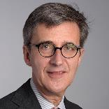
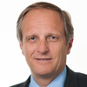
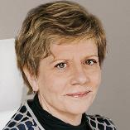
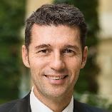
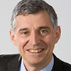
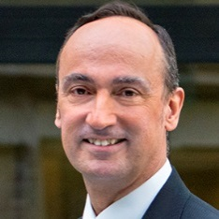
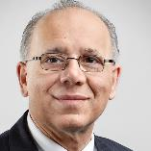
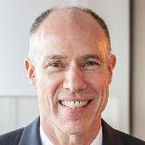
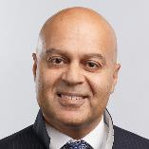
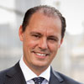
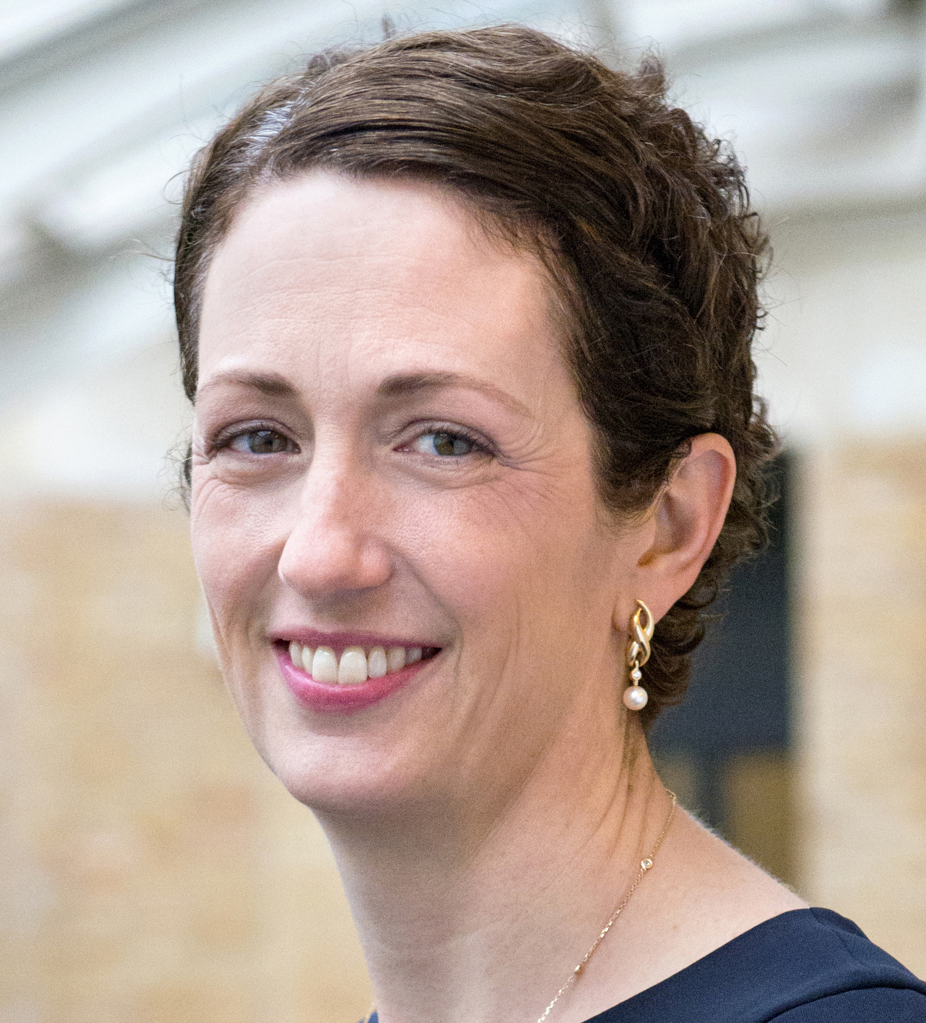
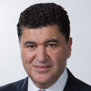
Governance
Focus on the Executive Committee
Olivier Brandicourt
Chief Executive Officer
Olivier Charmeil
General Medicines & Emerging Markets
Jérôme Contamine
Finance
Peter Guenter
Diabetes & Cardiovascular
Karen Linehan
Legal Affairs & General Counsel
David Loew
Sanofi Pasteur
Vaccines
Philippe Luscan
Global Industrial Affairs
Alan Main
Consumer Healthcare
Muzammil Mansuri
Strategy & Business Development
David P. Meeker
Sanofi Genzyme
Specialty care
Ameet Nathwani
Chief Medical Officer
Roberto Pucci
Human Resources
Kathleen Tregoning
External Affairs
Elias Zerhouni
Global R&D

Slide 20

We are a global healthcare leader committed to discover, develops and distribute therapeutic solutions focused on patients' needs.
Improving access to healthcare and providing the best support to you through a full continuum of care - from prevention to treatment including disease management - guide our actions day by day.
In the context of a changing world - from climate issues to longer life expectancy - we are all facing greater health challenges.
We strive to transform scientific innovations into therapeutic solutions that make a difference to your daily life wherever you live and enable you to enjoy a healthier life.

Slide 21
Recommendations
This corporate presentation is available for all employees in the Sanofi Company. It may be used internally or externally for presentations of the Group, either in whole or in part, as needed.
The information is taken from Form 20-F 2016, annual results 2016 and press releases.
Further information is available on www.sanofi.com
Forward-Looking Statements
This document contains forward-looking statements as defined in the Private Securities Litigation Reform Act of 1995, as amended. Forward-looking statements are statements that are not historical facts. These statements include projections and estimates and their underlying assumptions, statements regarding plans, objectives, intentions and expectations with respect to future financial results, events, operations, services, product development and potential, and statements regarding future performance. Forward-looking statements are generally identified by the words “expects”, “anticipates”, “believes”, “intends”, “estimates”, “plans” and similar expressions. Although Sanofi’s management believes that the expectations reflected in such forward-looking statements are reasonable, investors are cautioned that forward-looking information and statements are subject to various risks and uncertainties, many of which are difficult to predict and generally beyond the control of Sanofi, that could cause actual results and developments to differ materially from those expressed in, or implied or projected by, the forward-looking information and statements. These risks and uncertainties include among other things, the uncertainties inherent in research and development, future clinical data and analysis, including post marketing, decisions by regulatory authorities, such as the FDA or the EMA, regarding whether and when to approve any drug, device or biological application that may be filed for any such product candidates as well as their decisions regarding labelling and other matters that could affect the availability or commercial potential of such product candidates, the absence of guarantee that the product candidates if approved will be commercially successful, the future approval and commercial success of therapeutic alternatives, Sanofi’s ability to benefit from external growth opportunities and/or obtain regulatory clearances, risks associated with intellectual property and any related pending or future litigation and the ultimate outcome of such litigation, trends in exchange rates and prevailing interest rates, volatile economic conditions, the impact of cost containment initiatives and subsequent changes thereto, the average number of shares outstanding as well as those discussed or identified in the public filings with the SEC and the AMF made by Sanofi, including those listed under “Risk Factors” and “Cautionary Statement Regarding Forward-Looking Statements” in Sanofi’s annual report on Form 20-F for the year ended December 31, 2016. Other than as required by applicable law, Sanofi does not undertake any obligation to update or revise any forward-looking information or statements.
Credits photos: cover: © PeopleImages.com / Ocean / Corbis - p.2 : © G. Blonsky / Capa Pictures - p.3: © Patrick Allard / REA - p.5: © Peter Stumpf / Capa Pictures, © Palani Mohan, © Pierre Olivier / Capa Pictures, © Chris Kirzeder, © N. Djama / Capa Pictures, © Pierre- Olivier / Capa Pictures, © Pierre Olivier / Capa Pictures, © Pierre Olivier / Capa Pictures, - p.8: © A. Wiseman / Capa Pictures, © Frédéric Belge / CAPA Pictures, © Sanofi Genzyme, © Sanofi Pasteur / Marizilda Cruppe, © Horsche / iStock - p.9: © Cédric Arnold / Capa Pictures - p.10: © Cédric Arnold / Capa Pictures - p.12: © Pierre Olivier / Capa Pictures - p.13 : © Pierre Olivier / Capa Pictures - p.14: © François Terrier - Image Source / Getty Images - p.15: © Gilles Corre - p.16: © Pierre Olivier / Capa Pictures - p.19: © Denis Félix, © Franck Parisot, © Gil LeFauconnier, © Romain Baltz, © Céline Clanet / Interlinks Image, © Alex Cretey Systerman / Interlinks Images, © Romain Baltz, © Marthe Lemelle, © Peter Allan / Interlinks, © Franck Parisot, © Peter Allan / Interlinks, © Franck Parisot, © Marthe Lemelle - p.20: © Cultura RM / Laura Doss / Getty Images.

Slide 22
Further information: www.sanofi.com
SANOFI
CORPORATE COMMUNICATIONS
54, rue La Boétie
75008 Paris, France
Tel. +33 (0)1 53 77 40 00

